Slide 1
Compton Effect
“when a monochromatic beam of high frequency (lower wavelength) radiation (e.g., X-rays and γ-ray) is scattered by a substance, the scattered radiation contains two type of wavelengths one having same wavelength as that of incident radiation while the other having the wavelength greater (or lower frequency) than that of incident radiations. This effect is known as Compton Effect.

Slide 2
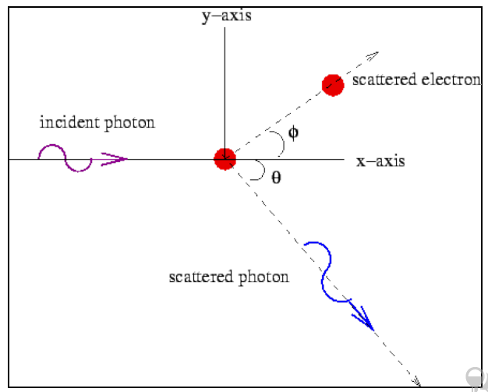

Slide 3
Quantum Explanation: The explanation was given by Compton which was based on quantum theory of light. According to quantum theory when photon of energy hυ strikes with the substance some of the energy of photon is transferred to the electrons, therefore the energy (or frequency) of photon reduces and wavelength increases.
Various assumptions were made for explaining the effect these were:
(i) Compton Effect is the result of interaction of an
individual particle and free electron of target.
(ii) The collision is relativistic and elastic.
(iii) The laws of conservation of energy and momentum
hold good.

Slide 4
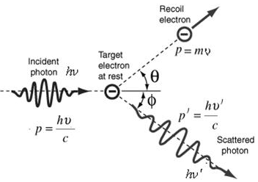


Psin𝜽
$$\frac{hυ^{/}}{c}cosφ$$
Pcos𝜽
$$\frac{hυ^{/}}{c}sinφ$$

Slide 5
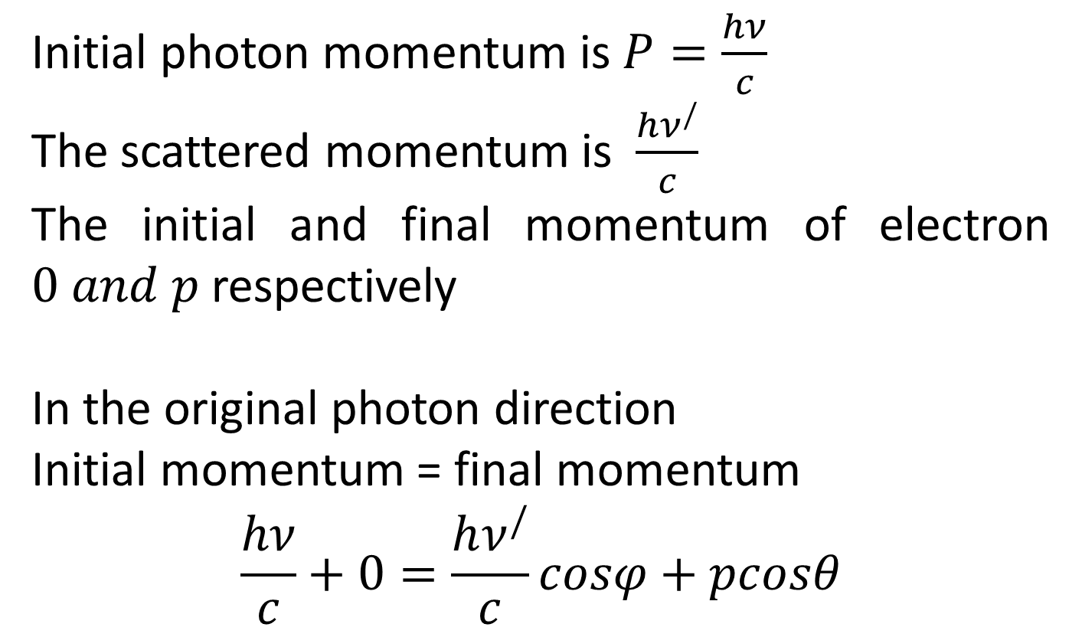
Initial photon momentum is $P=\frac{hν}{c}$
The scattered momentum is $\frac{hν^{/}}{c}$
The initial and final momentum of electron $0 and p$ respectively
In the original photon direction
Initial momentum = final momentum
$$\frac{hν}{c}+0=\frac{hν^{/}}{c}cosφ+pcosθ$$

Slide 6
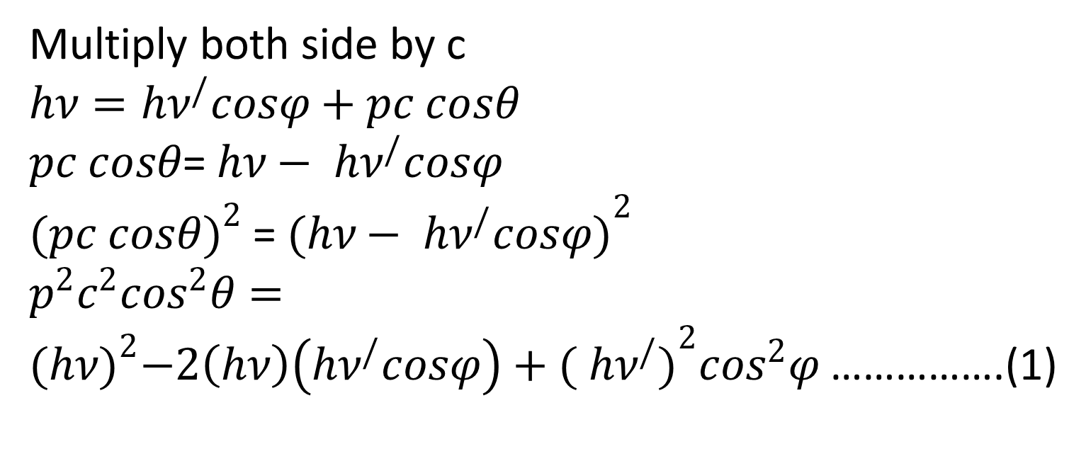
Multiply both side by c
$$hν=hν^{/}cosφ+pc cosθ$$
$pc cosθ$=$hν− hν^{/}cosφ$
${(pc cosθ)}^{2}$=${(hν− hν^{/}cosφ)}^{2}$
$p^{2}c^{2}\cos^{2}θ={(hν)}^{2}−2\left(hν\right)\left(hν^{/}cosφ\right)+{( hν^{/})}^{2}\cos^{2}φ$ …………….(1)

Slide 7
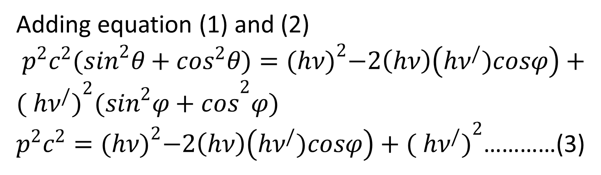
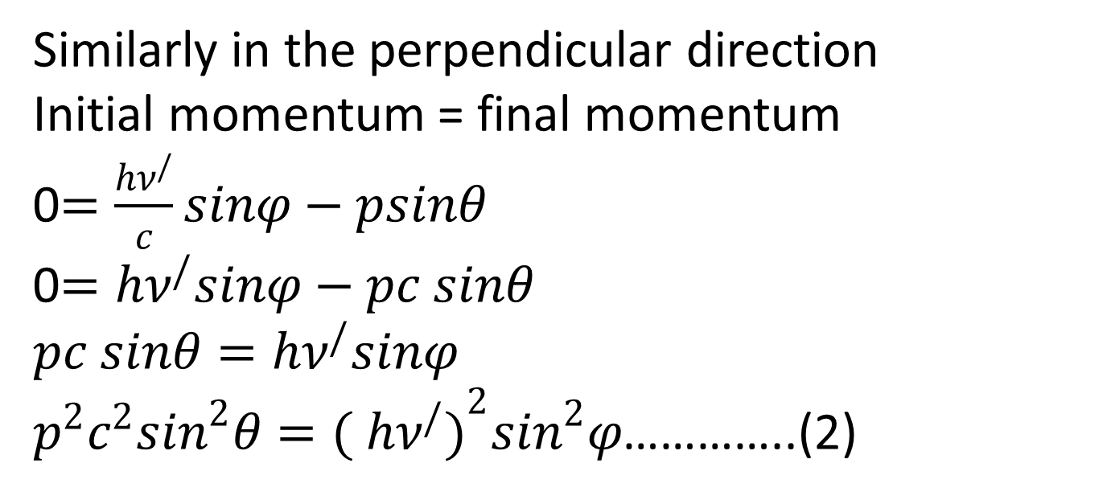
Similarly in the perpendicular direction
Initial momentum = final momentum
0$=\frac{hν^{/}}{c}sinφ−psinθ$
0$=hν^{/}sinφ−pc sinθ$
$pc sinθ=hν^{/}sinφ$
$p^{2}c^{2}\sin^{2}θ={( hν^{/})}^{2}\sin^{2}φ$…………..(2)
Adding equation (1) and (2)
$p^{2}c^{2}(\sin^{2}θ+\cos^{2}θ)={(hν)}^{2}−2\left(hν\right)\left(hν^{/})cosφ\right)+{( hν^{/})}^{2}({\sin^{2}φ+cos}^{2}φ)$
$p^{2}c^{2}={(hν)}^{2}−2\left(hν\right)\left(hν^{/})cosφ\right)+{( hν^{/})}^{2}$…………(3)

Slide 8

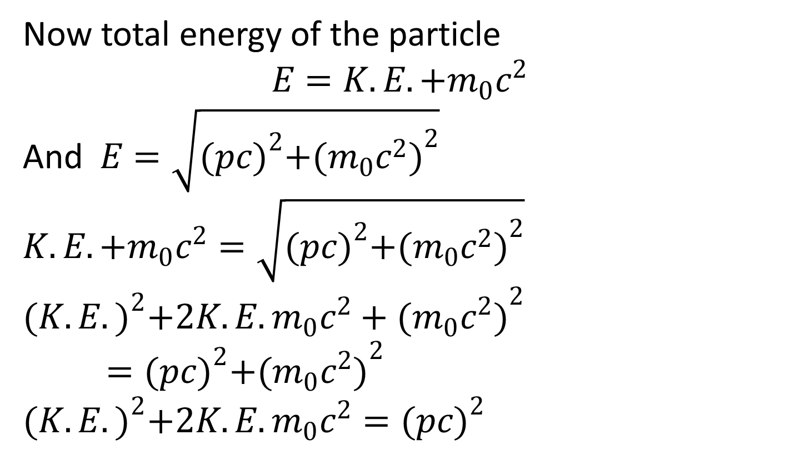
Now total energy of the particle
$$E=K.E.+m_{0}c^{2}$$
And $E=\sqrt{{(pc)}^{2}+{(m_{0}c^{2})}^{2}}$
$$K.E.+m_{0}c^{2}=\sqrt{{(pc)}^{2}+{(m_{0}c^{2})}^{2}}$$
$${(K.E.)}^{2}+2K.E.m_{0}c^{2}+{(m_{0}c^{2})}^{2}={(pc)}^{2}+{(m_{0}c^{2})}^{2}$$
$${(K.E.)}^{2}+2K.E.m_{0}c^{2}={(pc)}^{2}$$
But we know $hν=hν^{/} +K.E.$
$$hν−hν^{/} =K.E.$$

Slide 9
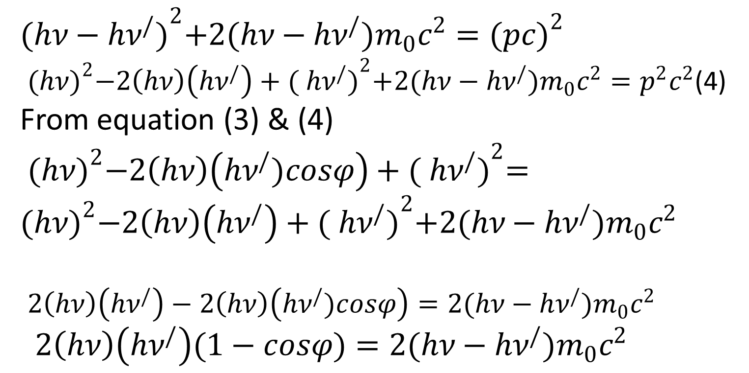
$${(hν−hν^{/})}^{2}+2(hν−hν^{/})m_{0}c^{2}={(pc)}^{2}$$
${(hν)}^{2}−2\left(hν\right)\left(hν^{/}\right)+{( hν^{/})}^{2}+2(hν−hν^{/})m_{0}c^{2}=p^{2}c^{2}$(4)
From equation (3) & (4)
${(hν)}^{2}−2\left(hν\right)\left(hν^{/})cosφ\right)+{( hν^{/})}^{2}={(hν)}^{2}−2\left(hν\right)\left(hν^{/}\right)+{( hν^{/})}^{2}+2(hν−hν^{/})m_{0}c^{2}$
$2\left(hν\right)\left(hν^{/}\right)−2\left(hν\right)\left(hν^{/})cosφ\right)=2(hν−hν^{/})m_{0}c^{2}$
$2\left(hν\right)\left(hν^{/}\right)(1−cosφ)=2(hν−hν^{/})m_{0}c^{2}$

Slide 10
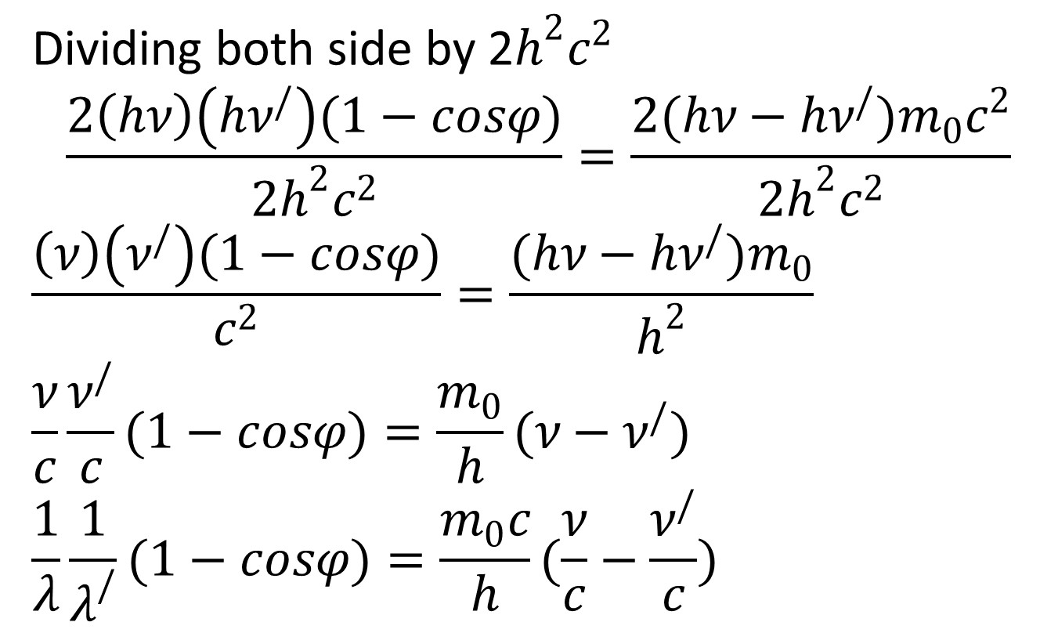
Dividing both side by 2$h^{2}c^{2}$
$$\frac{2\left(hν\right)\left(hν^{/}\right)(1−cosφ)}{2h^{2}c^{2}}=\frac{2(hν−hν^{/})m_{0}c^{2}}{2h^{2}c^{2}}$$
$$\frac{\left(ν\right)\left(ν^{/}\right)(1−cosφ)}{c^{2}}=\frac{(hν−hν^{/})m_{0}}{h^{2}}$$
$$\frac{ν}{c}\frac{ν^{/}}{c}(1−cosφ)=\frac{m_{0}}{h}(ν−ν^{/})$$
$$\frac{1}{λ}\frac{1}{λ^{/}}(1−cosφ)=\frac{m_{0}c}{h}(\frac{ν}{c}−\frac{ν^{/}}{c})$$

Slide 11
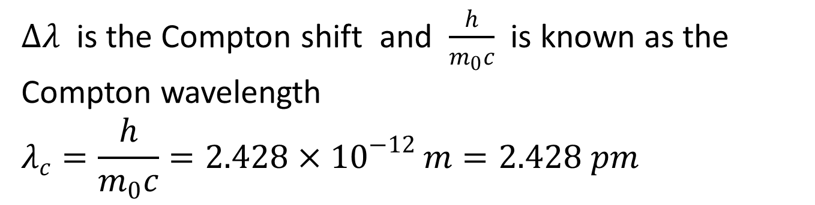
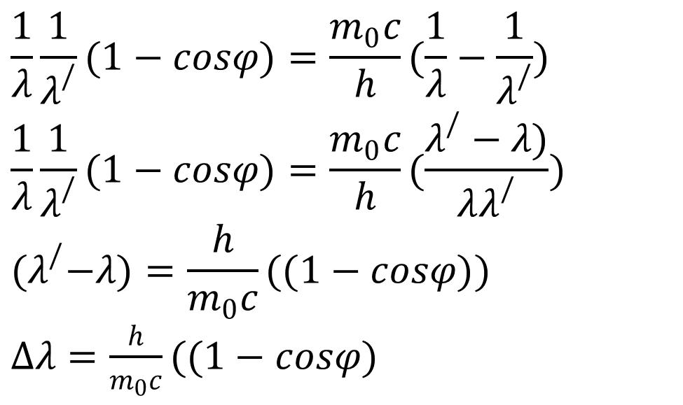
$$\frac{1}{λ}\frac{1}{λ^{/}}(1−cosφ)=\frac{m_{0}c}{h}(\frac{1}{λ}−\frac{1}{λ^{/}})$$
$$\frac{1}{λ}\frac{1}{λ^{/}}(1−cosφ)=\frac{m_{0}c}{h}(\frac{λ^{/}−λ)}{λλ^{/}})$$
$${(λ}^{/}−λ)=\frac{h}{m_{0}c}((1−cosφ))$$
$∆λ=\frac{h}{m_{0}c}((1−cosφ)$
$∆λ$ is the Compton shift and $\frac{h}{m_{0}c}$ is known as the Compton wavelength
$$λ_{c}=\frac{h}{m_{0}c}=2.428×{10}^{−12 }m=2.428 pm$$

Slide 12
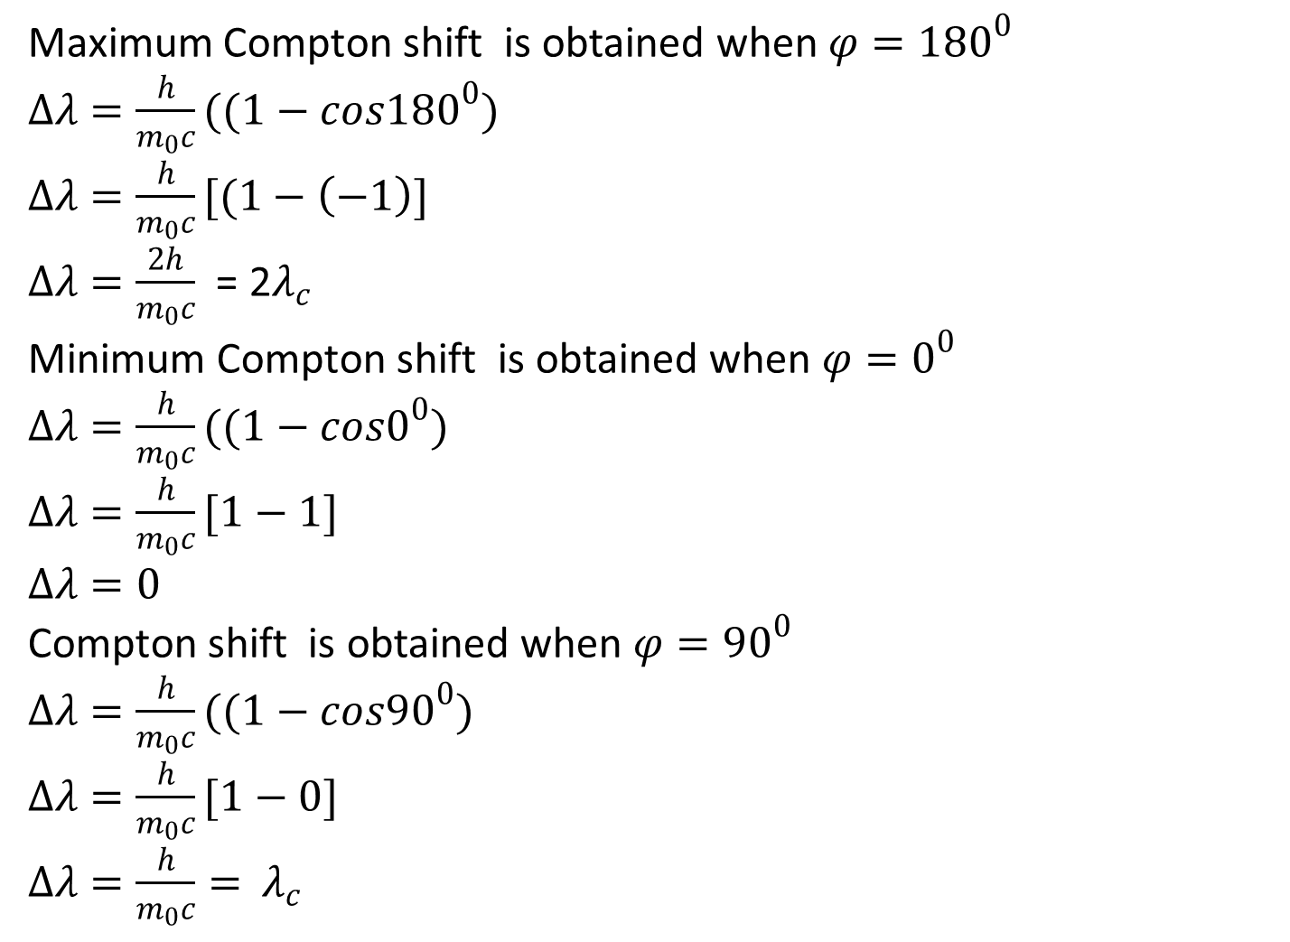
Maximum Compton shift is obtained when $φ={180}^{0}$
$∆λ=\frac{h}{m_{0}c}((1−cos{180}^{0})$
$∆λ=\frac{h}{m_{0}c}[(1−\left(−1\right)]$
$∆λ=\frac{2h}{m_{0}c}$ = 2$λ_{c}$
Minimum Compton shift is obtained when $φ=0^{0}$
$∆λ=\frac{h}{m_{0}c}((1−cos0^{0})$
$∆λ=\frac{h}{m_{0}c}[1−1]$
$∆λ=0$
Compton shift is obtained when $φ=90^{0}$
$∆λ=\frac{h}{m_{0}c}((1−cos90^{0})$
$∆λ=\frac{h}{m_{0}c}[1−0]$
$∆λ=\frac{h}{m_{0}c}=$ $λ_{c}$

Slide 13
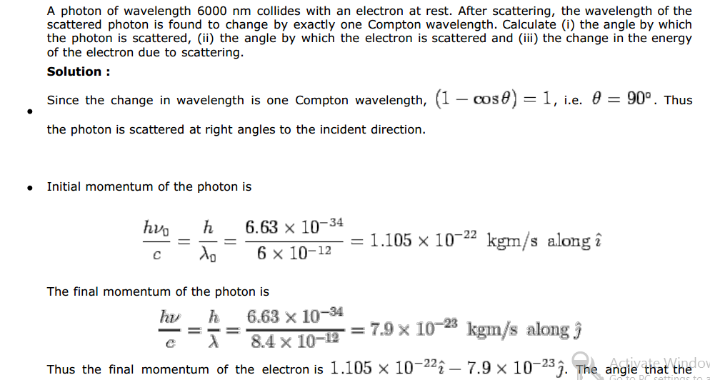

Slide 14
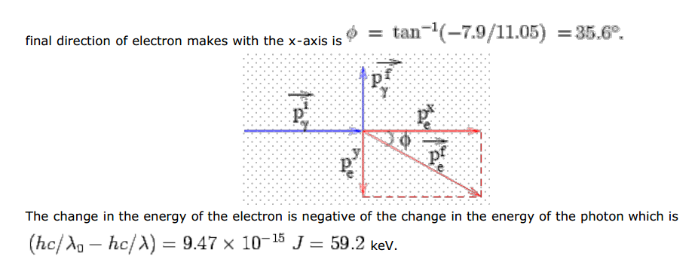

Slide 15
